Slide 1
Smart Briquetting
A monitoring and controlling system for biothermic process

Slide 2

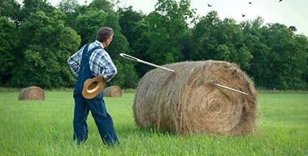

Slide 3
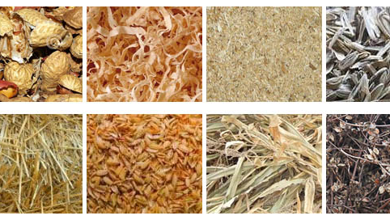
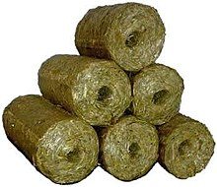
Let’s talk about ‘Briquette’
A briquette (or briquet) is a compressed block of coal dust or other combustible biomass material such as charcoal, sawdust, wood chips, peat, or paper used for fuel and kindling to start a fire. The term comes from the French language and is related to brick.
-Wikipedia

Slide 4
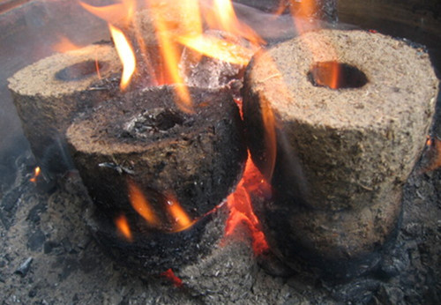
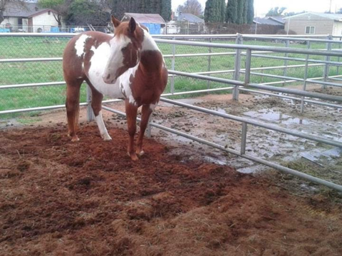
Uses of Briquettes
Using as fuel for steam generation and heating of boilers
winter heating in cold areas and in restaurants
Heating Green houses , Nurseries and Chicken coops.
Bedding or litter for farm animals

Slide 5
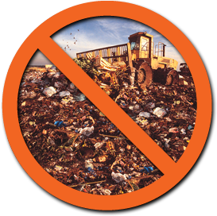


Why Briquetting?
Reduces cost substantially 30-40% (vs. coal)
Reduces CO2 emission 15-40% (vs. coal)
Reduces landfill and bio waste
Less dependency on fossil fuel

Slide 6
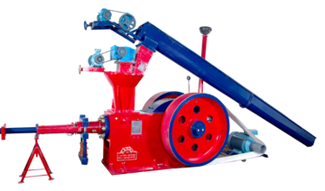
How it is done…..

Slide 7
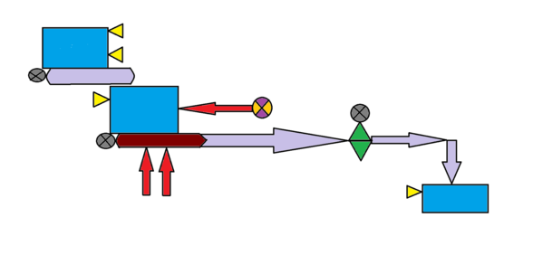
Input Bucket 1
Conveyor Belt
Heating Fan
Chopping Saw
Input Bucket 2
Conveyor Belt
Radiator
Output
Bucket
Generic Briquetting Machine Schema

Slide 8

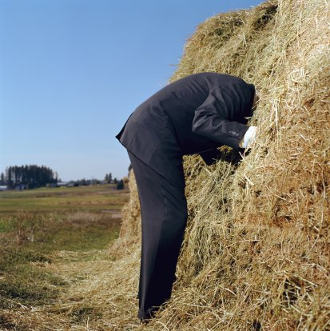

Slide 9
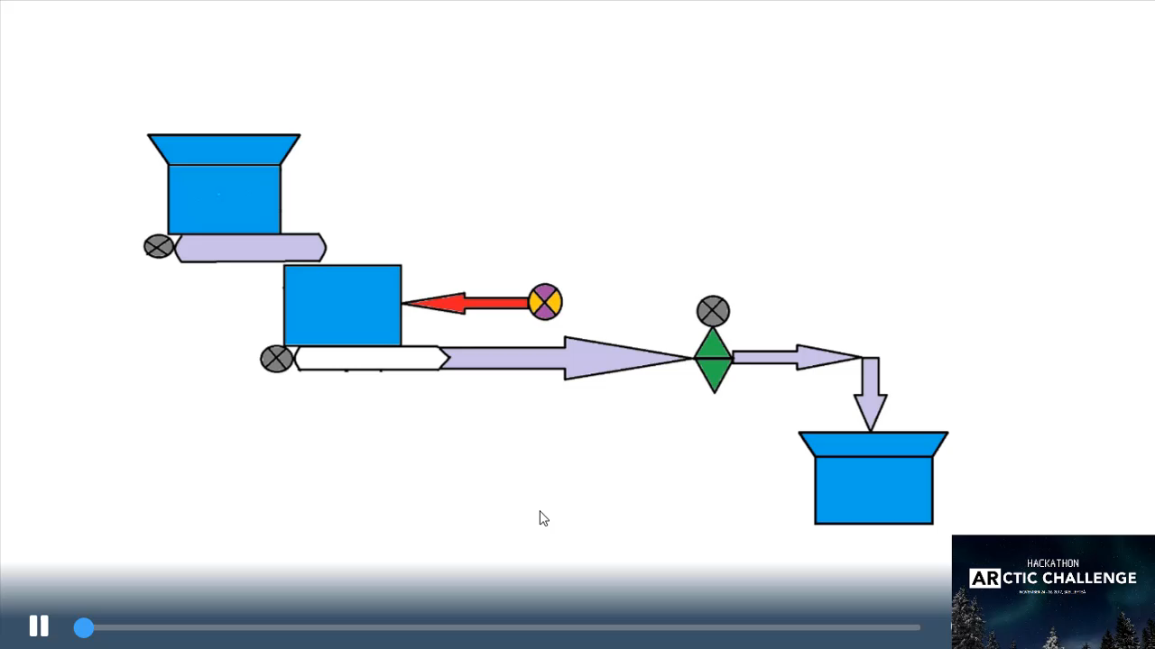
The Smart System

Slide 10
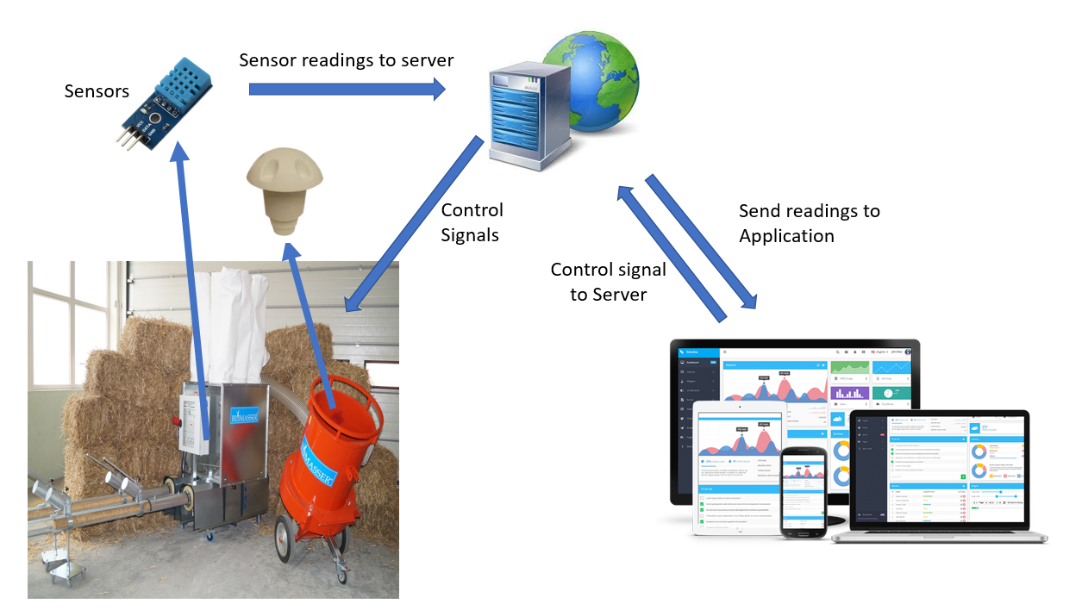
System Architecture

Slide 11
Users access to cockpit !

Slide 12

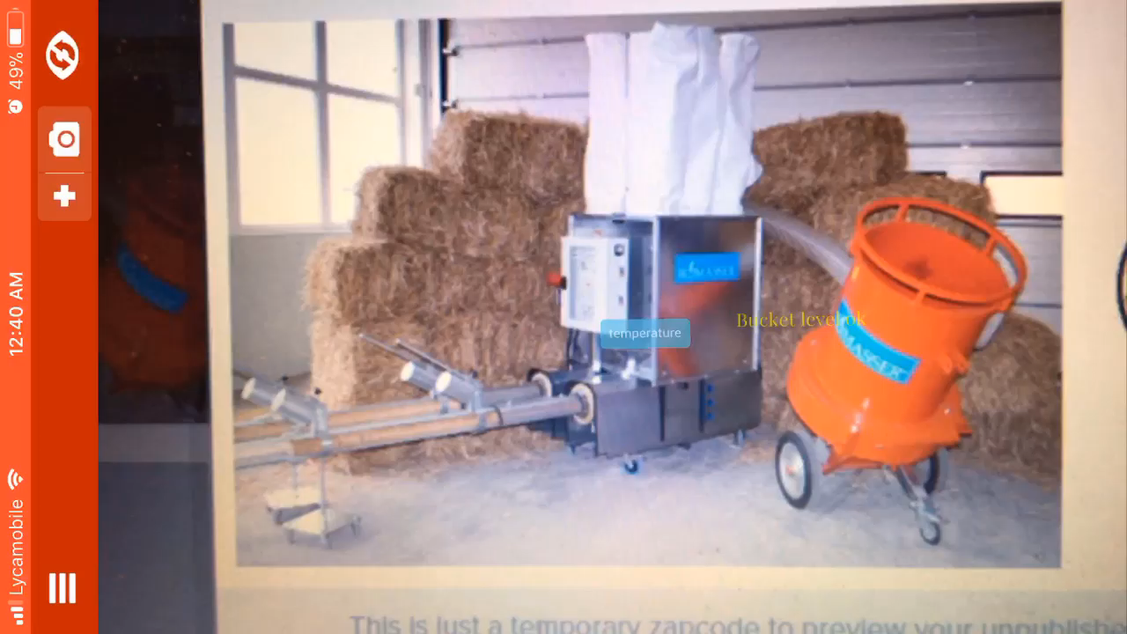
Lets make it Armani

Slide 13

Lets ask Siri….

Slide 14



Slide 15
Thank You

